Slide 1
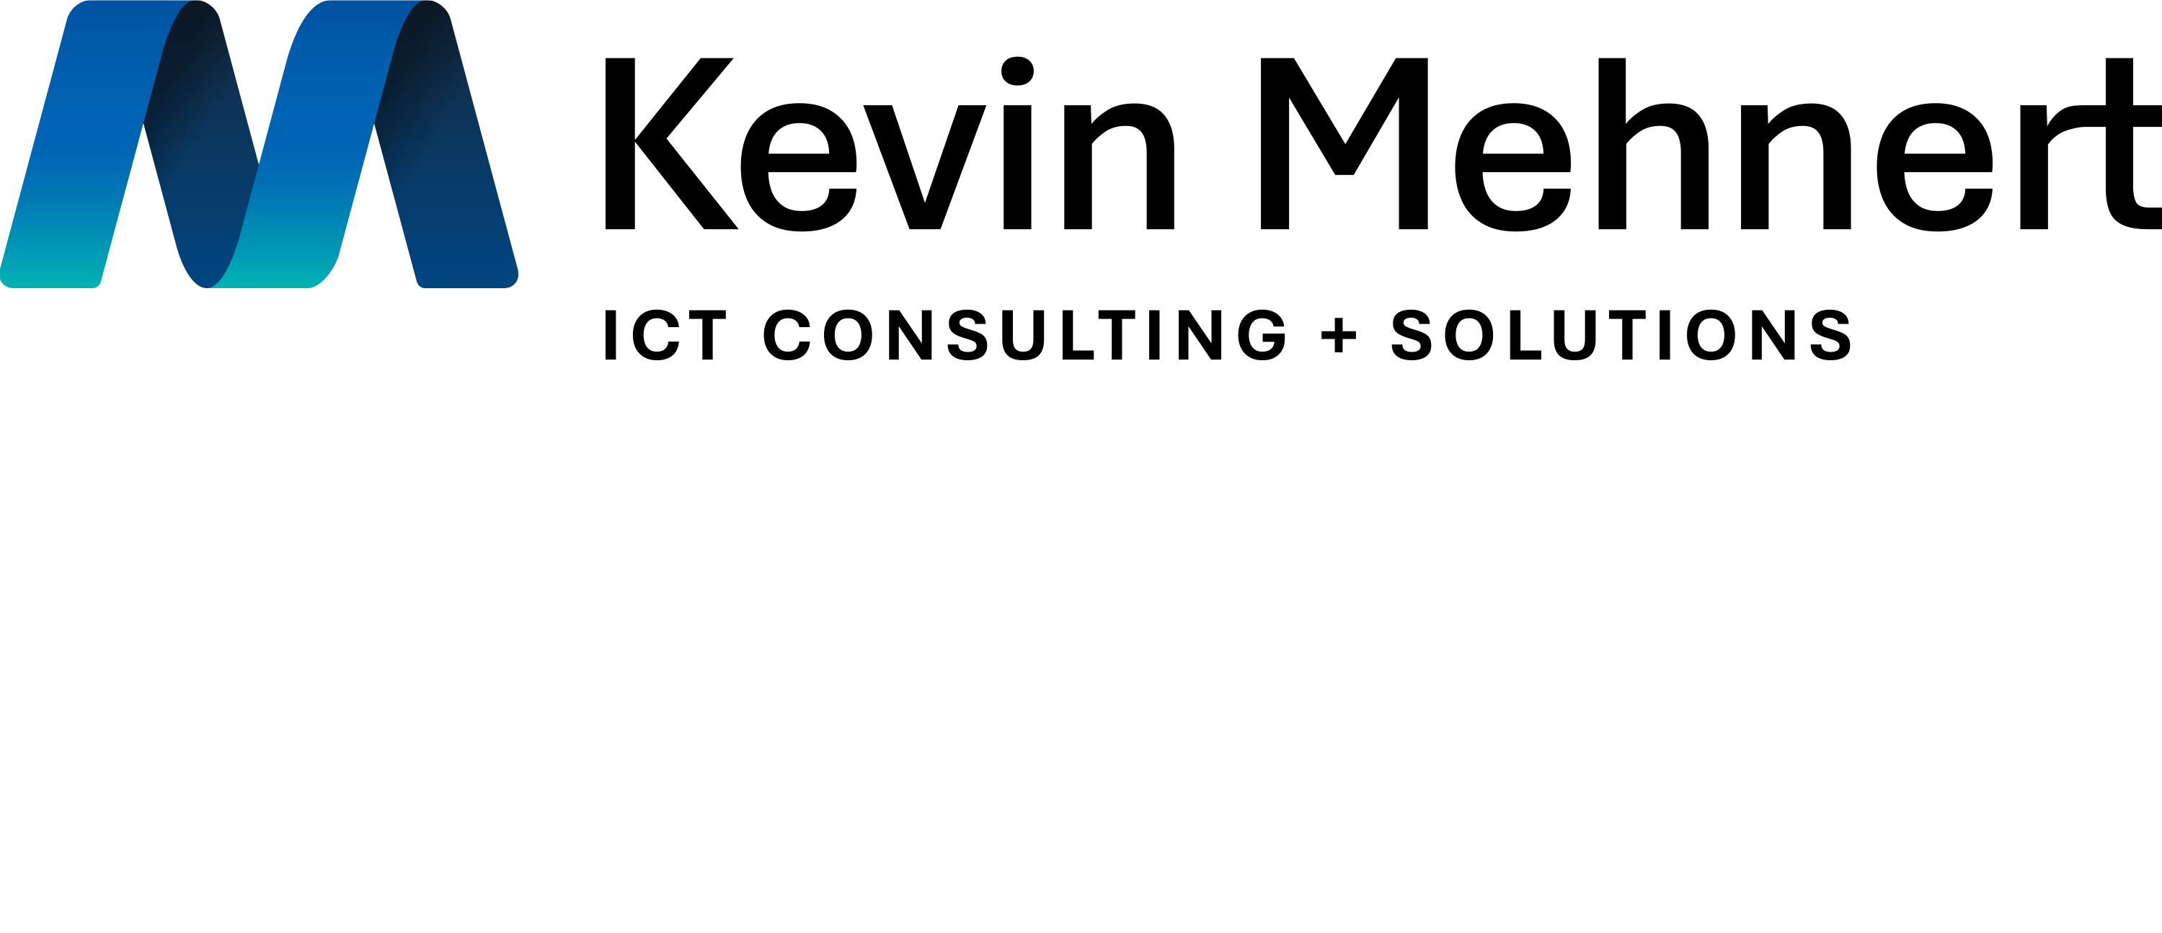

Build big with generative AI
Azure AI services can empower you to build and deploy your own AI solutions through large language models. Modernize your processes, accelerate development, and run responsibly anywhere with enterprise-grade security.
Responsibility
Filter and moderate content to ensure that coding and language of your AI models are used responsibly and for their intended purpose.
Scalability
Experience performance that stands out in today’s market and over the horizon—pressure-tested AI across apps, data, and AI infrastructure solutions.
Ways to infuse generative AI into next-gen app experiences
Content generation
Automatically generate responses to customer queries. Generate personalized UI for your website.
Summarization
Summarize customer support conversations, financial reports, articles, social media trends.
Code generation
Convert natural language to SQL (or vice versa) for telemetry data, query proprietary data models.
Semantic search
Perform information discovery and knowledge-mining. Search reviews for a specific product or service.
Azure AI services
Azure AI Language
Azure AI
Vision
Azure AI
Speech
Azure AI
Decision
Azure
OpenAI
Azure AI Cognitive Search
Azure AI Form Recognizer
Azure AI
Bot Service
Azure AI Video Analyzer
Azure AI Metrics Advisor
Azure AI Immersive Reader
Azure Machine Learning platform
Machine Learning
Consider this your experimentation platform for large language models enabling:
Prompt design, evaluation, and deployment.
Choice in fine-tuning of either OpenAI or open-source software models.
Powerful AI infrastructure with GPUs.
Contact us and discover opportunities to accelerate growth with AI
Kevin Mehnert ICT - Sales Support | Kevin Mehnert ICT | Support@kmict.de | kmict.de

